Slide 1

AutoConnect Inc.
In-Vehicle Coupon Recommendation
Notes:
Oleg:
For the following project, we used the “In-Vehicle Coupon Recommendation” system that the team already worked on previously, and added certain modifications, such as dynamic weather data, to modify the architecture in place, create an updated model and draw additional insights using a dynamic dashboard

Slide 2

AutoConnect Inc. Team
Arunima Agrawal (arunima29) - Data Scientist
Aishwarya Choukekar (aishwaryachoukekar) - Data Analyst
Arpit Nagpal (ArpitNagpal96) - Product Manager
Smitul Soni (smitulsoni) - Data Scientist
Shehryar Hussain (Shehryar-Hussain) - Business Analyst
Yichen Wang (yicwang) - Business Analyst
Diwei Zhu (JuniperZhuDiwei) - UI/UX Specialist
Oleg Kartavtsev (oleg19989) - Business Analyst
Notes:
Oleg:
Our team is composed of a wide range of specialties from business analyst to data scientist and product manager

Slide 3



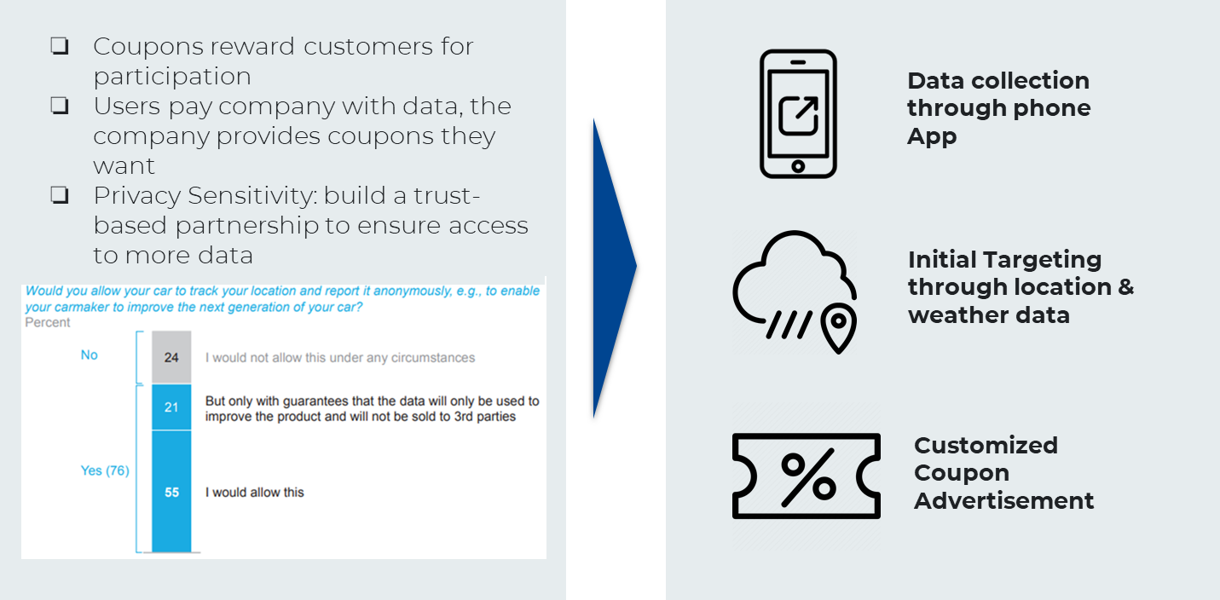


Notes:
Oleg:
Our proof of concept is to provide in-vehicle advertising through coupons.
Why coupons? People are sensitive to privacy concerns, but are more willing to share data when they get something in return.
So we turn data into a currency, incentivise customers to trust us => so we can collect more private data
Benefit for consumer: see deals they might have missed out on
Benefit for grocery store: customer goes into store with products in mind, more likely to purchase more

Slide 4
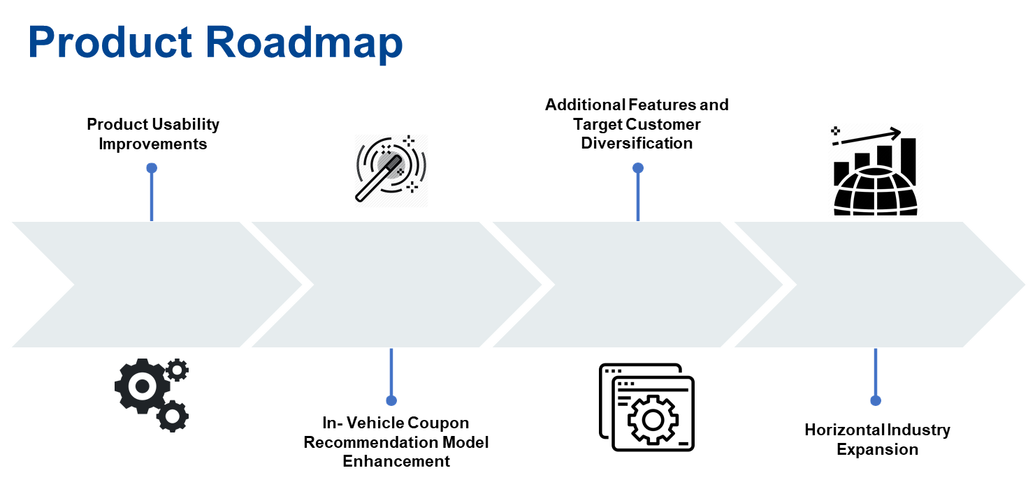
Phase 1
Phase 2
Phase 3
Phase 4
Notes:
Oleg:
The future roadmap of the product is defined to map the transition from In-Vehicle Coupon Recommendation Proof-of-Concept for F&B based on the given dataset to a production level large scale V2B (Vehicle to Business) and V2X (Vehicle to Everything) Product with the following four defined phases:
1.Product Usability Improvements: Initial product coupon recommendation is based on real-time weather data and location data available via customer mobile devices. To enhance product usability based on the current provided data, enhance the accuracy of GPS or location data
Unsupervised learning models to create customer segments to enhance targeting
1.In-Vehicle Coupon Recommendation Model Enhancement: The next step is to enhance in-vehicle coupon recommendation engine to expand the recommendation system to other market players such as fuel station retailers, car washes and grocery stores . Additionally, the customers would be exposed to demographic data collection, resulting in better recommendations for F&B and e-commerce partners to introduce in-vehicle advertisements and targeted marketing strategies. These e-commerce and F&B marketing strategies would be based on collaborations based on historical data.
2.Additional Features and Target Customer Diversification: The next stage would be to enhance data collection strategies and accordingly enhance target customers based on the data collected. With the power of IoT, big data analytics, data cloud streaming and high-resolution positioning, the target customers are diversified from just in-vehicle drivers to automotive sector players (data feedback based R&D and warranty costs reduction), insurance firms (vehicle monitoring and scoring), traditional stores and malls (Traffic data based retail footprint and stock level optimization)
3.Horizontal Industry Expansion: Based on the customer target diversification, AutoConnect would enter multiple verticals using it’s data collection and analytics technology to break the vehicle data market. Moreover, in-vehicle users adoption of the product enhances due to additional product features (based on subscription) such as usage based insurance - Pay as you drive (PAYD) and Pay how you drive (PHYD), breakdown call services, enhanced vehicle service level insights based on predictive modelling and establishing a P2P carpooling network. Based on the service subscriptions, these data points would be shared with businesses and market players for monetization.

Slide 5
What changed?
Static weather data
Real-time weather
Dynamic data
Short-term: recent weather events
Coupon distribution failed to consider weather changes in ± couple of hours. E.g. it is rainy only when the hour the customer submit the survey
Enabling analysis based on weather events of recent past/near future to better determine coupon type & maximize cost-saving
Middle-term: seasonality
Weather events (rain, snow, etc.) have seasonal features. E.g. precipitations in summer and fall could indicate different coupon strategies
Dynamic weather data can account for seasonal, monthly, even weekly weather patterns
Long-term: climate change
Climate change induce long-term and gradual change of regional weather patterns.
Instilling dynamic weather data help the model gradually adapt to long-term change on daily base
Notes:
Oleg:
One of the major updates from the previous iteration of this project is that we replaced static weather data with the real-time weather dynamic data for the city of Montreal. This has a number of benefits of varying degree. Short-term, it enables us to conduct better analysis of recent past/near future so we can recommend coupons better. It also allows us to account for seasonal, monthly and weekly weather patterns. Long-term, this helps the model to gradually adapt to these dynamic changes.

Slide 6
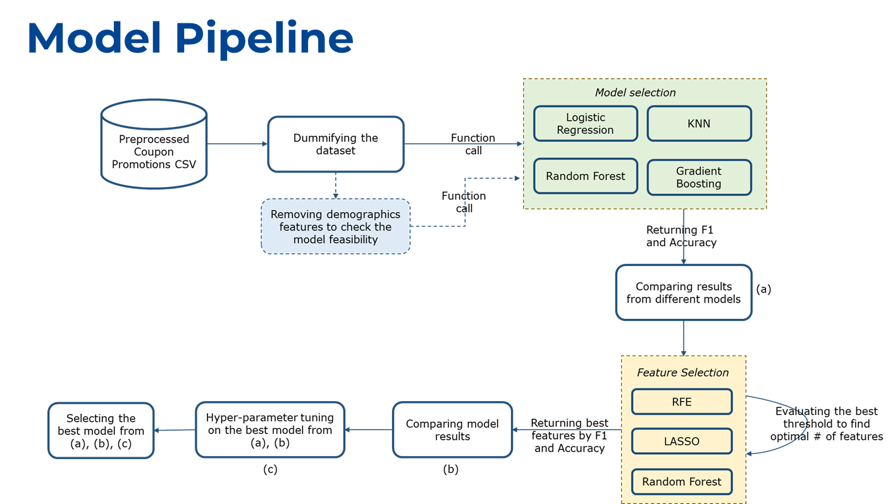
Modeling Recap
Preliminary Model Pipeline:
Notes:
Arpit:
Data comes from surveys sent to highly rated Amazon Mechanical Turk users, asked willingness to use coupon in different driving scenarios and with different coupon options: ex coupon for less then 20$ at restaurant more than 20 minutes away
So what is Car Data? It is any data generated about the car itself, how it is and where it is and about the drivers, their behaviours and preferences. However, such kinds of customer data is always accompanied by privacy issues and through research, it is determined that data on location and car usage and status has relatively lower sensitivity but users are quite reluctant to share personal data.

Slide 7
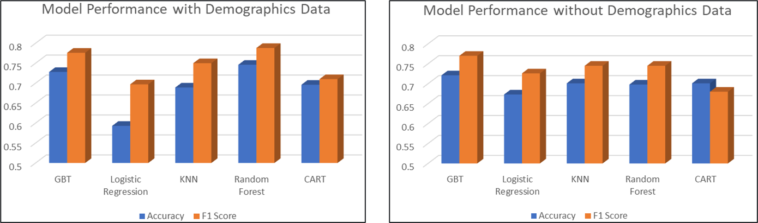
Modeling Recap
Demographic Data such as age and income are top predictors. Inclusion leads to better ad customization and higher probability for customer to accept the coupon.
Notes:
Arpit:
With Demographics:
Random Forest Results (26 features):
Accuracy: 0.75
F1 Score: 0.79
Without Demographics:
GBT Results (18 features):
Accuracy: 0.72
F1 Score: 0.77

Slide 8
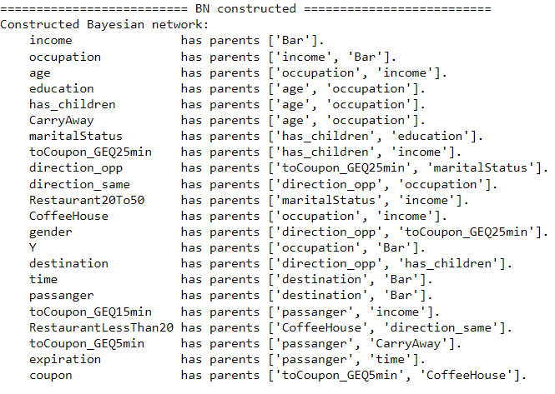
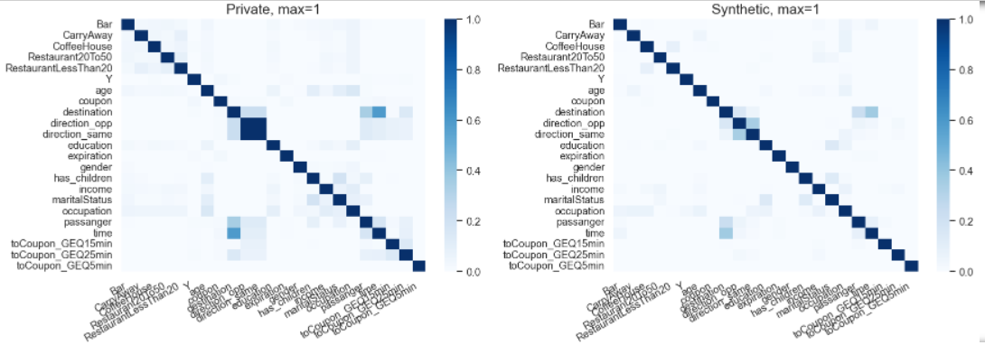
Synthetic Test Data Generation
Formation of a Bayesian Network (objects: describer, generator and inspector) using correlated attribute mode for ~12K training data i.e., original data for the generation of 21K testing tuples
Bayesian Network for Attribute Creation
Correlation Matrix Comparison: Original vs Synthetic Data
Notes:
Arpit:
# An attribute is categorical if its domain size is less than this threshold
threshold_value = 30
# A parameter in Differential Privacy
epsilon = 1
# The maximum number of parents in Bayesian network, i.e., the maximum number of incoming edges
degree_of_bayesian_network = 2
# Number of tuples generated in synthetic dataset
num_tuples_to_generate = 21000

Slide 9
Hyperparameter Optimization
Optuna - NewData
Random Forest Classifier
criterion: gini
bootstrap: False
max_features: 0.495
n_estimators: 271
min_samples_split: 11
74.01%
Hyperopt - New Data
Random Forest Classifier
criterion: entropy
bootstrap: False
max_features: 0.15
n_estimators: 300
min_samples_split: 9
72.72%
Notes:
Aishwarya: Considering RF was best model from Enterprise 1, running hyper parameter optimization on it using Optuna and Bayesian for the newly generated data. The hyper parameters selected by both are roughly similar and accuracy within close range as well.

Slide 10
Modeling Approach
TPOT
H2O
Random Forest Classifier
Gradient
Boosting
Enterprise II
Accuracy: 0.76
Random Forest Classifier
Accuracy: 0.76
This accuracy score is very similar to the our main model presented in Enterprise 1.
However, TPOT saved us manual effort of finding the best possible estimator.
Accuracy is similar to TPOT.
However, much more computational time and resources.
So we go ahead with TPOT chosen random forest classifier.
Enterprise |
Notes:
Aishwarya: As part of AutoML process, we tried running two algos TPOT and H2O to find the best possible estimator. The best accuracy so far is with TPOT. H2O roughly has same accuracy but ends up using lot more computational power and resources. It also expects components to be used as per H2O frame. So looking at all aspects of it, TPOT does come up with better hyperparameters and good accuracy so going forward we use the model suggested by TPOT.

Slide 11
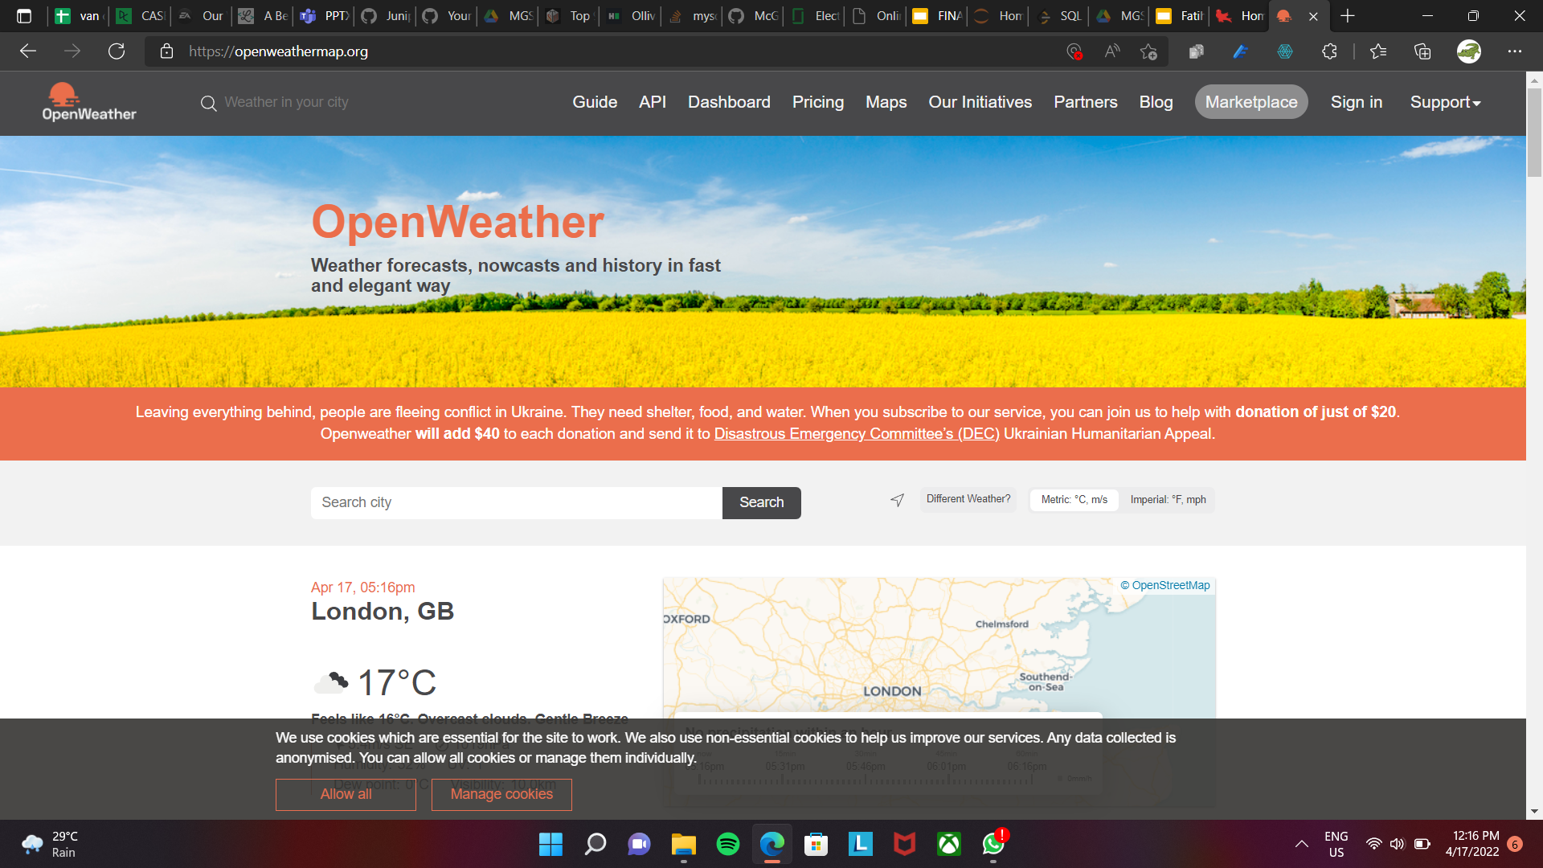
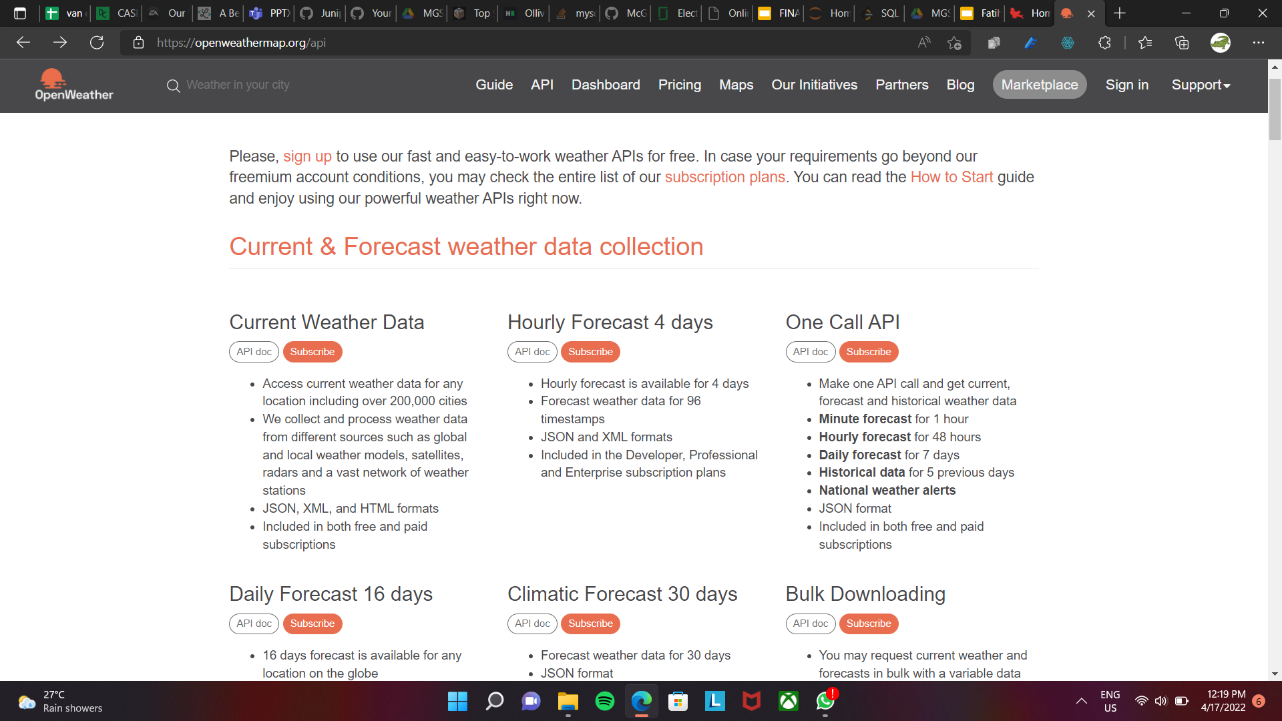
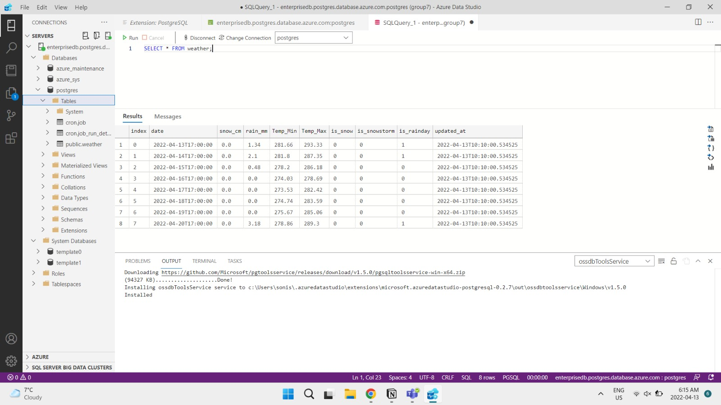
External Data - Dynamic weather
Instead of static weather data, we capture dynamic weather data with OpenWeather API from its open-source database
Weather Data API for predicting weekly weather info
Dynamic weather events: rainy, snowy, temperature
Montreal city weather data
Notes:
Arunima/Smitul: Previously, we used static data which included predictors providing information about the target customers and coupons. Weather fields used for analysis were also static. As the extension of our project, we enabled the analysis to be done dynamically, where the weather data for Montreal city is extracted daily using the Open Weather API. This information about rainfall, snowfall, minimum and maximum temperature, is now combined with the main dataset to generate predictions.

Slide 12
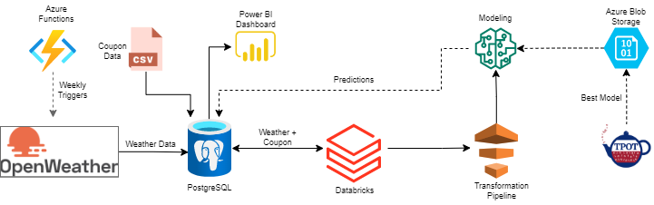



Solution Architecture
CRON:
0 5 4 * * *
Notes:
Arunima/Smitul: We used Azure components including Azure Functions, Azure Blob Storage, Azure PostegreSQL database, and deployed the solution on Databricks. I will start by discussing the datasets used for analysis. We created a database in Azure PostgreSQL, and placed the coupons data in the database. Next, we created an Azure time-triggered function, scheduled to run at 12:05AM EST everday. This function gets the weather data daily using the Open Weather API, and stores this in the database. Then we run a databricks cluster, and import the datasets from the database. The data is passed through the data transformation pipeline, which cleans the data, performs one hot encoding, etc. We used TPOT to assess the final model and its hyperparameters. This trained model is stored in Azure Blob Storage as a .sav file. Using databricks, we access the model stored in Azure storage to make predictions on the test data. These predictions are stored in the PostgreSQL database. Finally, a Power BI dashboard is created for the company’s management to make decisions.

Slide 13
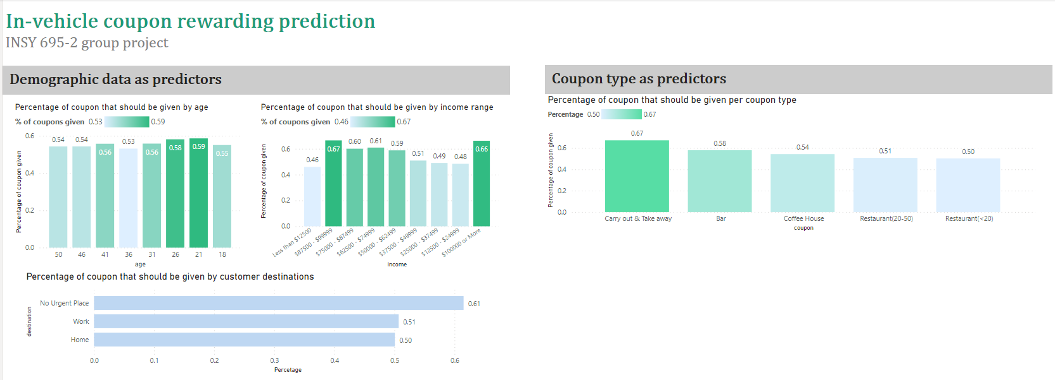
Power BI visualization of results
—— Coupons should be given to whom?
Customers of age 21 or 26, and have a high annual income of $87500-$99999 or $100000 or more have the highest chance of receiving coupons.
Customers going to a not urgent destination have higher chance to get coupons.
67% Coupons for carry out/take away were predicted to be given
Notes:
Diwei

Slide 14

Implications – From the identified model prediction pattern
Future extensions
To collect more data – Target more on the identified populations that have higher incentives of giving out the data encouraged by coupons
More informed about how the model works. If not satisfied with the pattern/preference of the predictions, we can consider tuning the model.
Real enterprise deployment scenario
Addition of other external datasets: events data- hockey games, concerts, which can lead to many people traveling across places, leading to potential rise in coupon popularity.
Deploying model with an endpoint in Azure ML, instead of storing it in Azure Blob Storage.
Enabling the test data streaming on a real-time basis using Confluent.
Increasing predictors for analysis based on model results and external researches.

Slide 15

Thank you!

